Slide 1



In the name of God
Project Title:
Introduction of Quantum walk: its application on search and decision-making
By: Mostafa Shabani

Slide 2
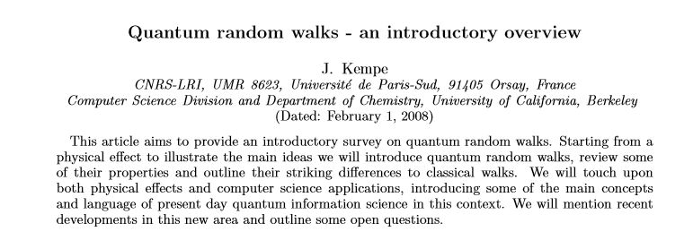
Quantum circuit implementation of the algorithm on the Qiskit platform

Slide 3

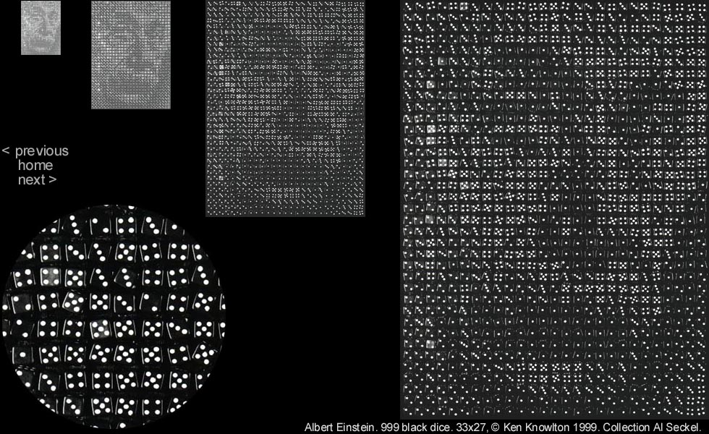

Slide 4
Quantum Walk:
Quantum walks: The quantum analogs of classical random walks
Moving particle explores the configuration space at some rate speeds
Quantum walk explore its configuration space at a much faster rate.
This is a consequence of the superposition principle, at each time step.
The moving particle initially at site n, simultaneously occupies the two neighboring sites with probabilities given by the square of the respective site amplitudes.
Continuous-time
Quantum walks
Discrete-time

Slide 5
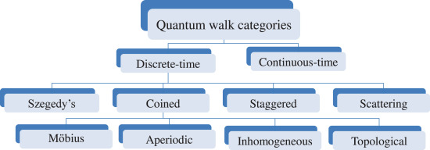

Slide 6
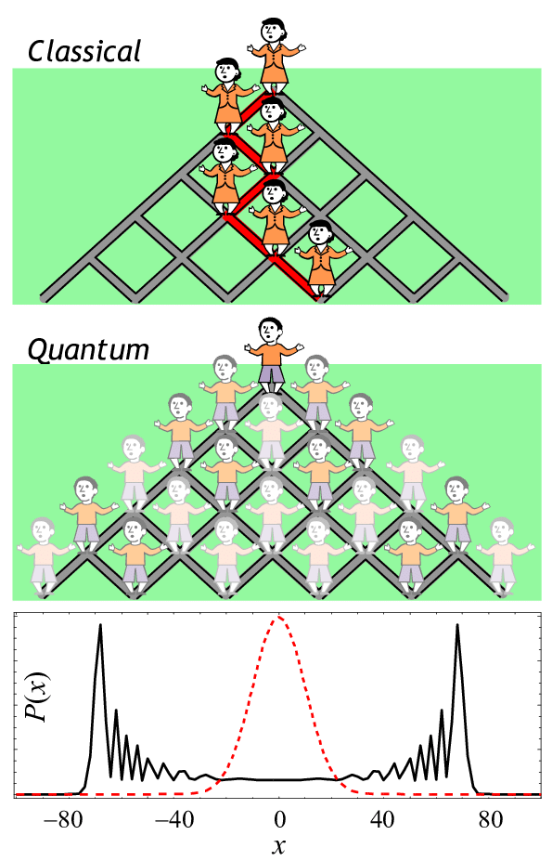

Slide 7
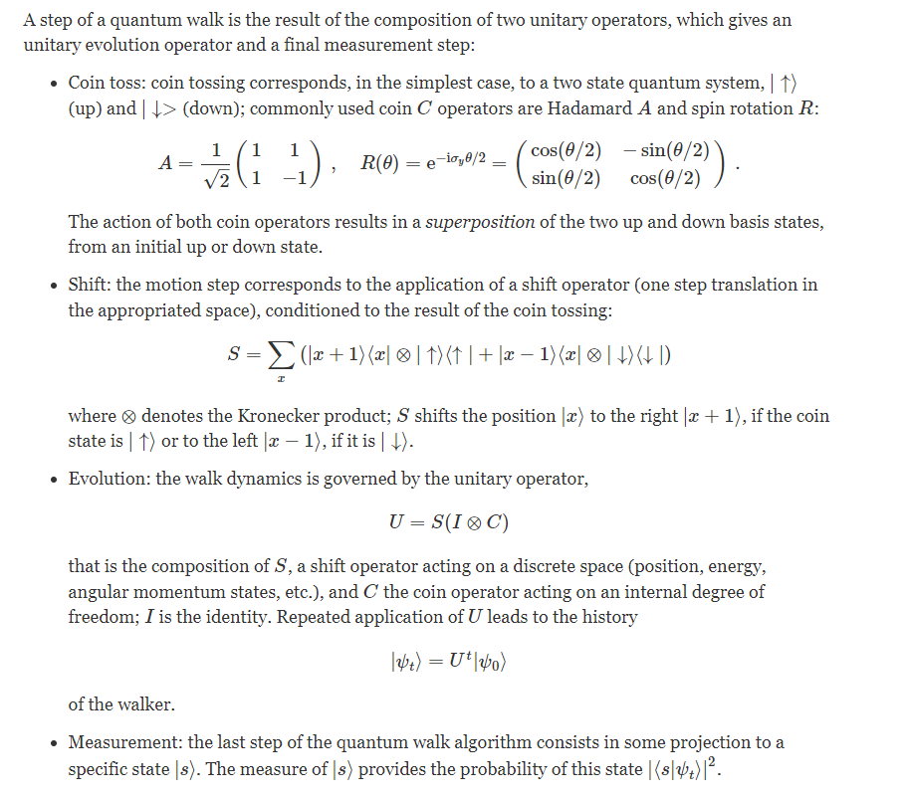
Discrete-time
Coined model

Slide 8
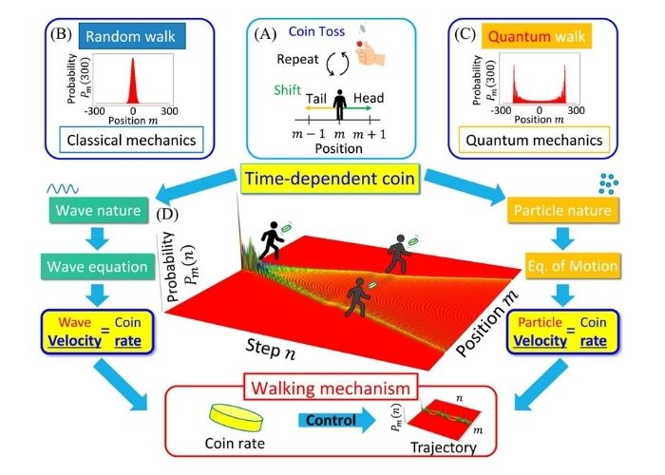

Slide 9
We encoded each position nodes on the graph in position
qubit states |q0,q1,…..> Pose qubits register
We encoded each link between nodes in coin qubit states |q0, q1, ….> Coin qubits register
Based on Coin, we walk on network by
Evolution operator
Encode the position of a "walker" in some n -dimensional space with a vector

Slide 10
Quantum Circuit Representation
Position Qubit register
Coin Qubit register
Increment gate
Decrement gate

Slide 11
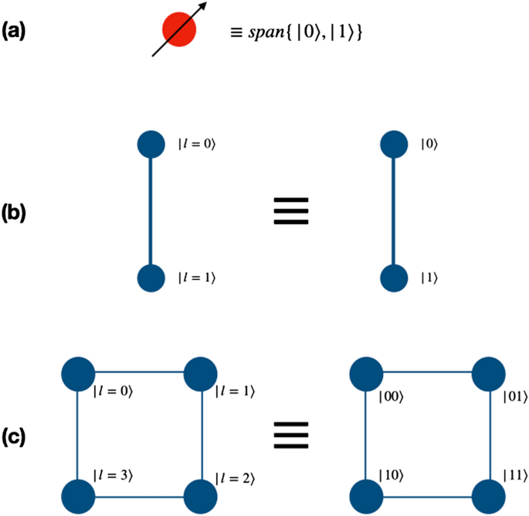
Position Qubits
Number network nodes
m qubits 2^m nodes
m=2 4 nodes

Slide 12
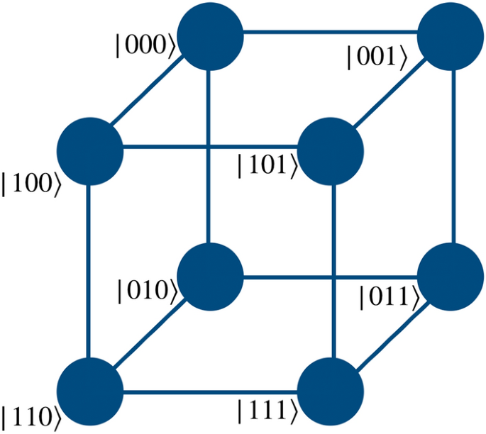
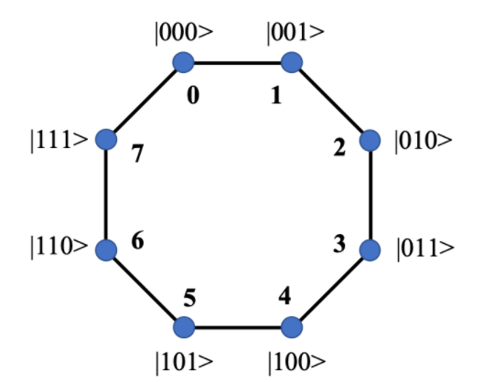
m=3 8 nodes
m=4 16 nodes
.
.
.

Slide 13
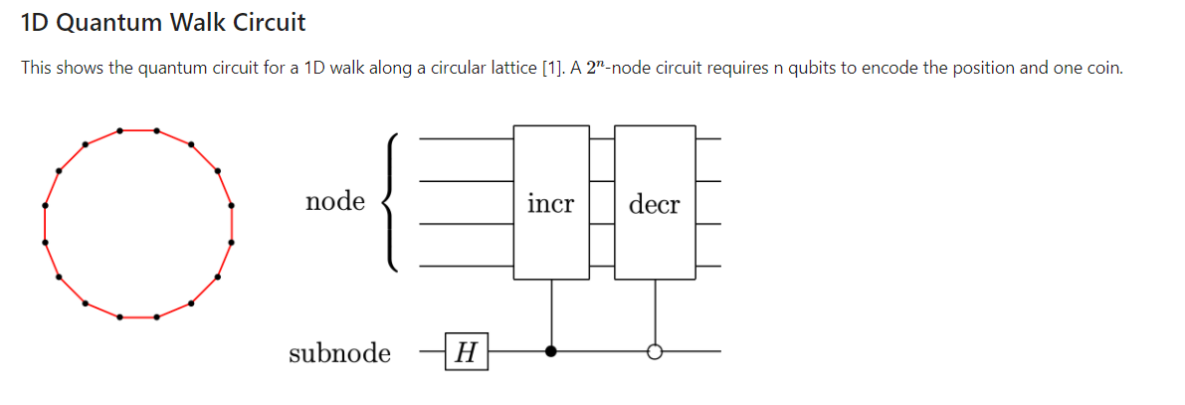
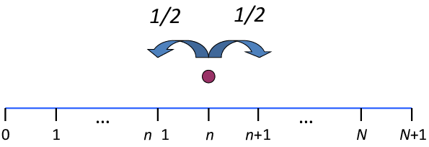
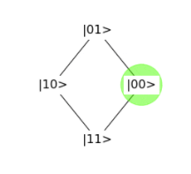
Coin Qubits
Number of links between network nodes
2 links 1 qubit left ← right → 1D WALK

Slide 14
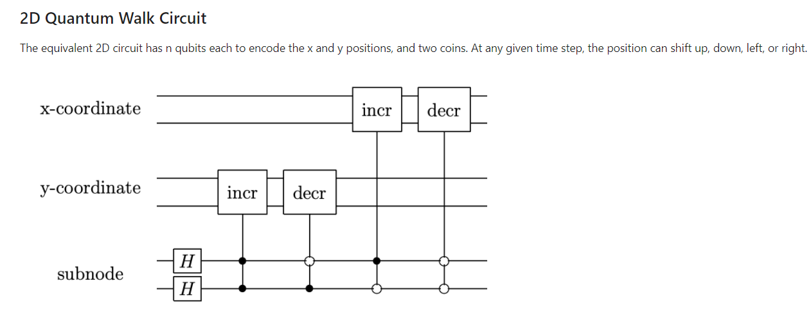
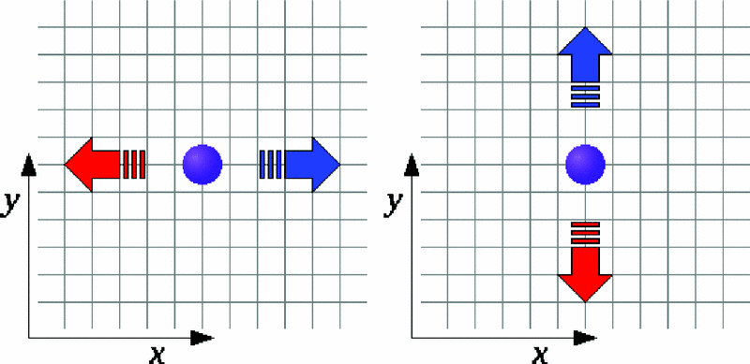
4 links 2qubits left ← right → up ↑ down ↓ 2D WALK

Slide 15
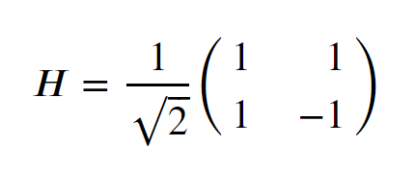
Quantum Circuit on Qiskit
We use 1 Coin
Hadamard Coin
General form for 2^m nodes (position)
n walk steps
m= number of position qubits
n= walk steps
(m,n)

Slide 16
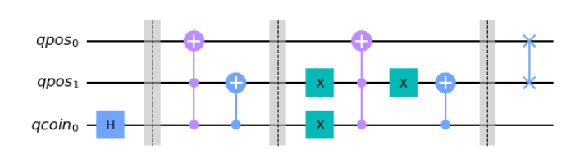
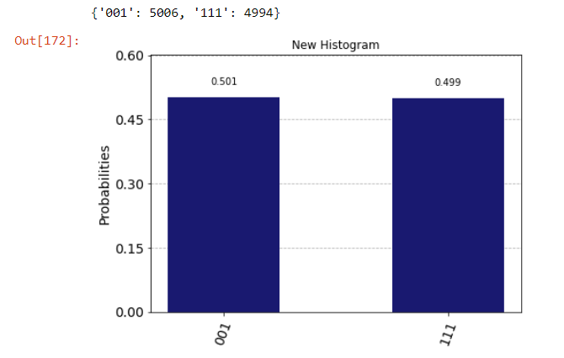
(2,1)
2^2=4 number of nodes
1 walk step

Slide 17
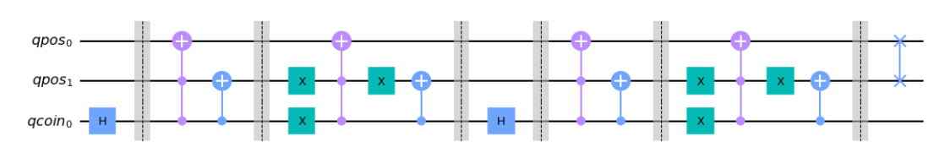
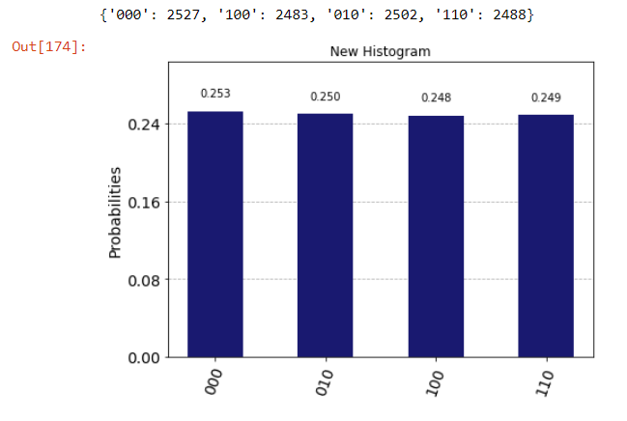
(2,2)
2^2=4 number of nodes
2 walk steps

Slide 18
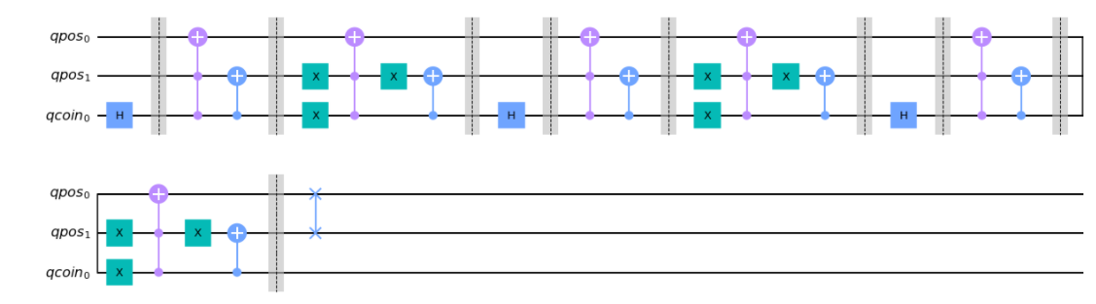
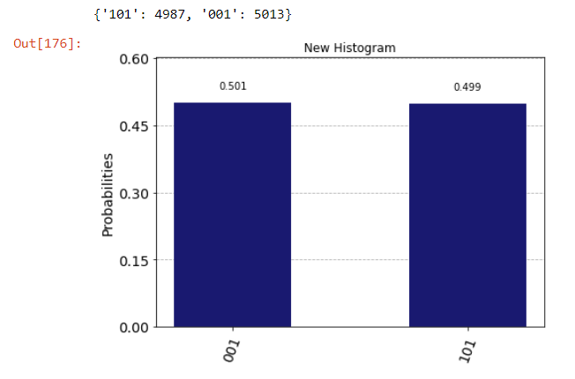
(2,3)
2^2=4 number of nodes
3 walk steps

Slide 19
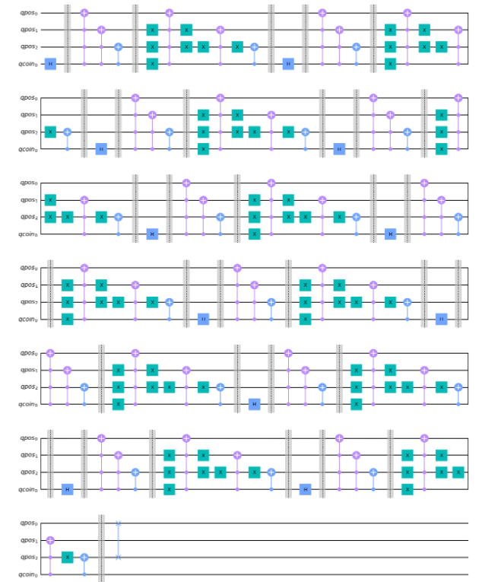
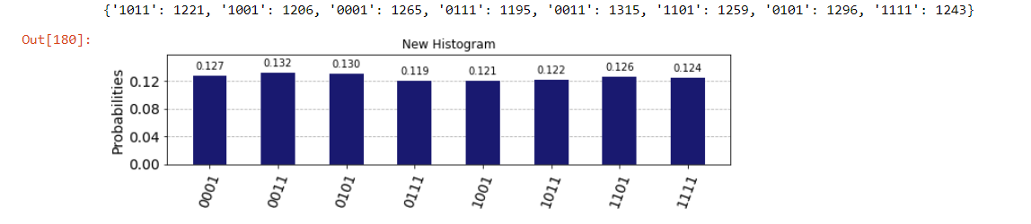
(3,11)
2^3=8 number of nodes
11 walk steps

Slide 20
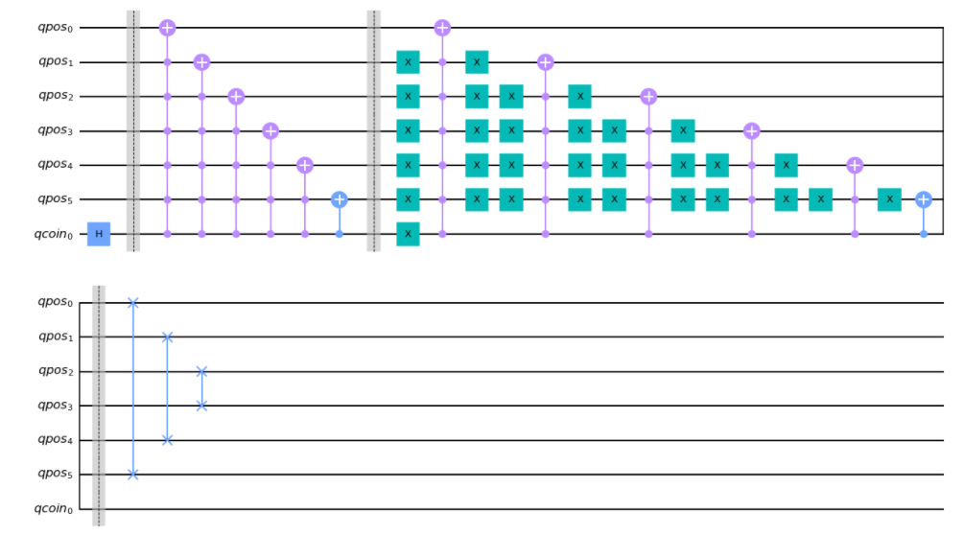
Coin initialized in state
Hadamard gate on Coin Qubit
(6,11)
2^6=64 number of nodes
11 walk steps

Slide 21
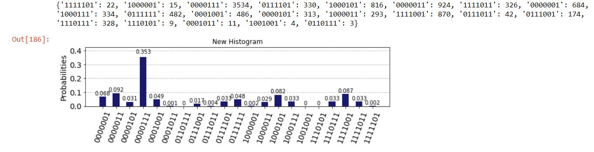
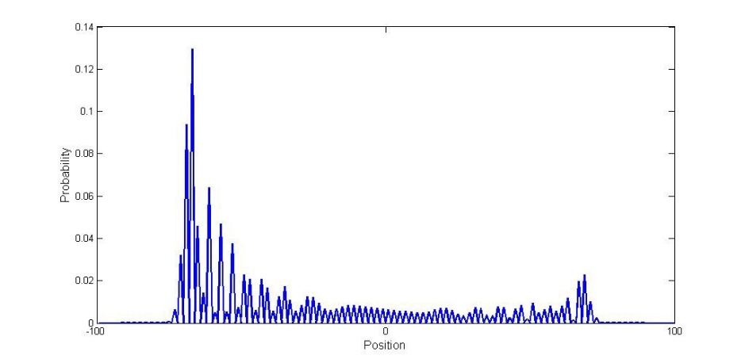
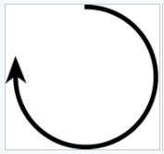
We have observed a Left shift for Probabilities distribution
Clockwise on circle

Slide 22
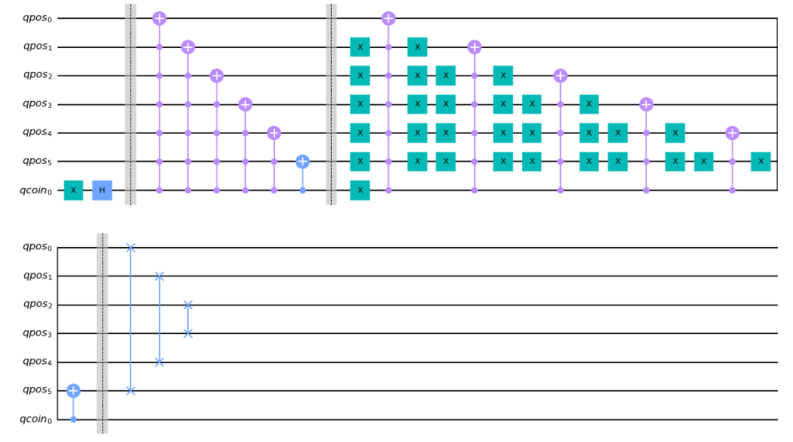
Coin initialized in state
By applying X and Hadamard gate on Coin Qubit
(6,11)
2^6=64 number of nodes
11 walk steps

Slide 23
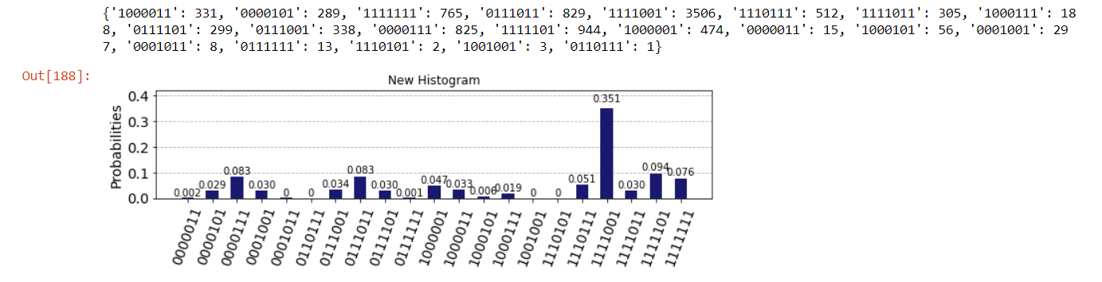
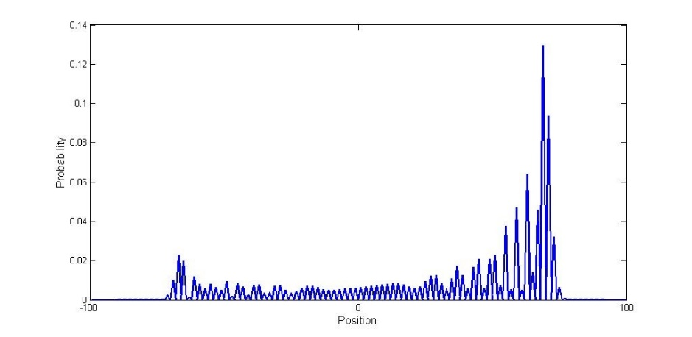
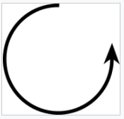
We have observed a Right shift for Probabilities distribution
Counterclockwise on circle

Slide 24
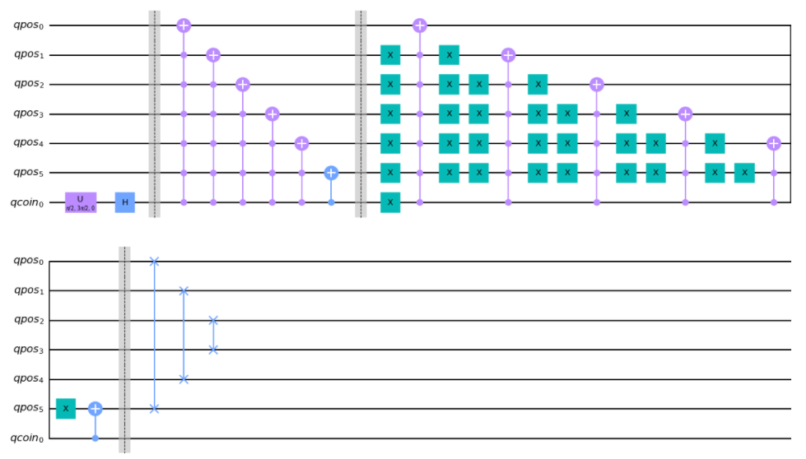
For Symmetric probability distribution
We apply Ugate before Hadamard gate on Coin Qubit to initialize coin state in
(6,11)
2^6=64 number of nodes
11 walk steps

Slide 25
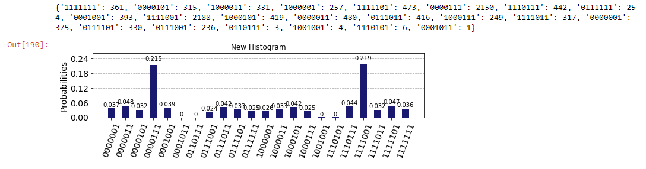
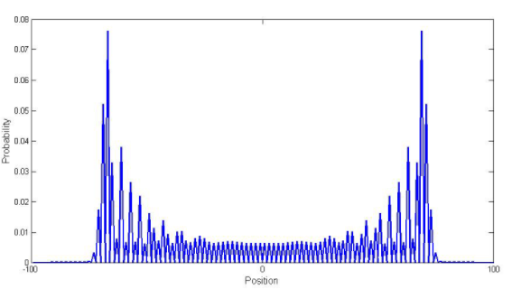
We have observed a Symmetric Probabilities distribution on graph nodes

Slide 26


